Slide 1
Loader
Loader Application User Guide

Slide 2
Introduction
XLC Loader is an application to process CSV files and dump the data into the database accordingly.
Multiple instances can be invoked for this application which executes and process files in-parallel.

Slide 3
Getting Started – System Requirements
Operating System: Microsoft windows 7 (x86 or x64) and above
Microsoft .Net Framework 4.5
OledbDriver (Can find the AccessDatabaseEngine_x64.exe setup in XLC application folder after installation)
IBM DB2 Client driver (Optional: if need to use DB2 database)
Teradata client driver (Optional: if need to use Teradata database)
Oracle client (Optional: if need to use oracle database)

Slide 4
Getting Started - Assumptions
Environment
All the required components are installed on the machine before continuing installation of XLC loader application.
The required Database structure already exists on database server.
The “inbox” folder already exist.

Slide 5
Getting Started - Assumptions
User
Have basic knowledge of Windows operating system and its basic functions.
Administrative rights on target machine.
Knows how to install application on the windows operating system
Knows how to install and configure the database client.

Slide 6
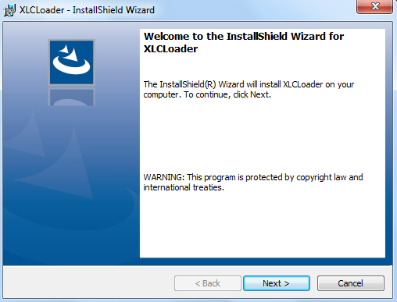
Getting Started – Installation - Application
Please follow these steps to install the application on the machine.
Download the setup file from FTP location.
ftp://172.21.12.166/XLC/
Execute the setup file to start install shield for installation processes.

Slide 7
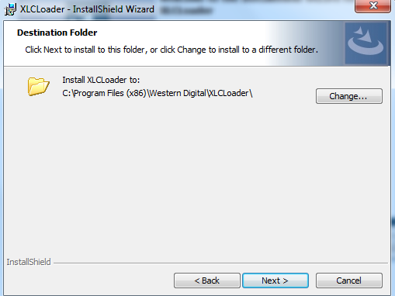
Getting Started – Installation - Application
Follow the instructions and install the application.
Select the destination folder where application needs to be installed and click “next”

Slide 8
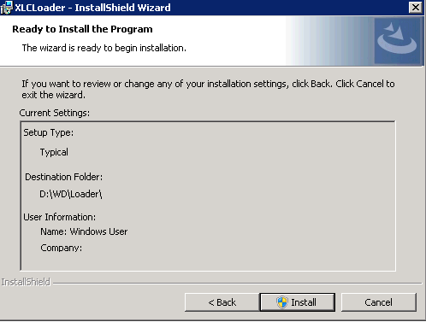
Getting Started – Installation - Application
Review the selected options summary and click “Install” to begin the installation.

Slide 9
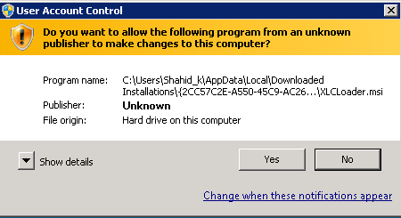
Getting Started – Installation - Application
Click yes if asked for administrative privileges.

Slide 10
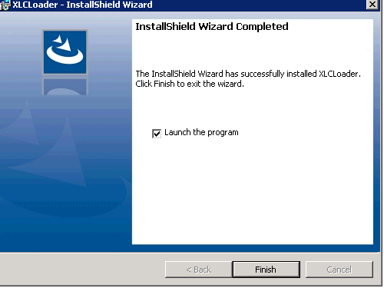
Getting Started – Installation - Application
After the installation is completed, click on finish to exit the install shield.

Slide 11
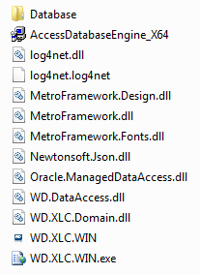

Getting Started – Installation - Application
The files in the installation folder will look like this.
The access database file is also part of installed files.
It contains the configuration tables.

Slide 12
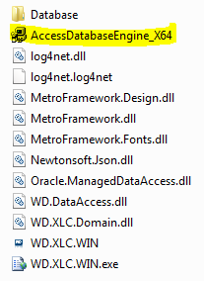
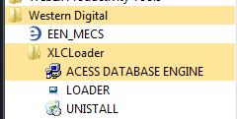
Getting Started – Installation – Access DB Engine
To install the Access database Engine please follow these steps.
Either go to application folder where the XLC application is installed
OR go to Start Menu > All Programs > Western Digital > XLC Loader and then selec “Acess Database Engine”.

Slide 13
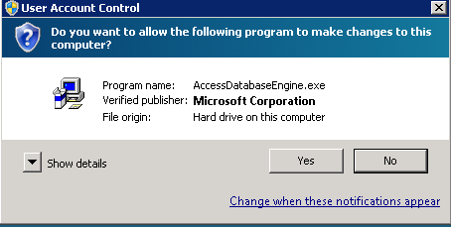
Getting Started – Installation – Access DB Engine
Click Yes to begin the installation

Slide 14
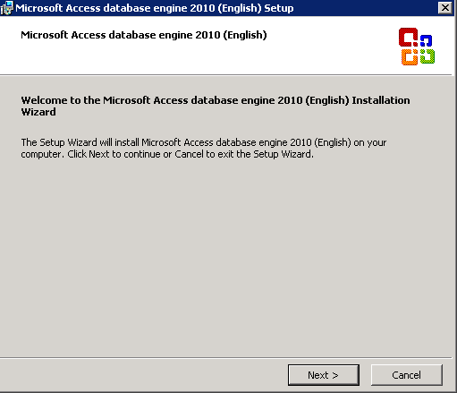
Getting Started – Installation – Access DB Engine
Follow the step-by-step instructions of install shield in order to complete the process. Click “Next” to begin.

Slide 15
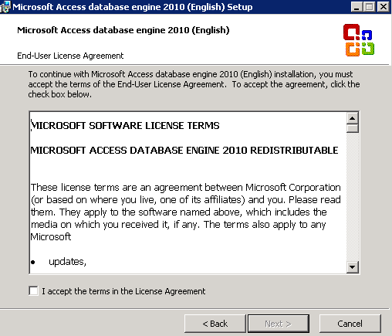
Getting Started – Installation – Access DB Engine
Select the checkbox to accept license agreement and click “Next”.

Slide 16
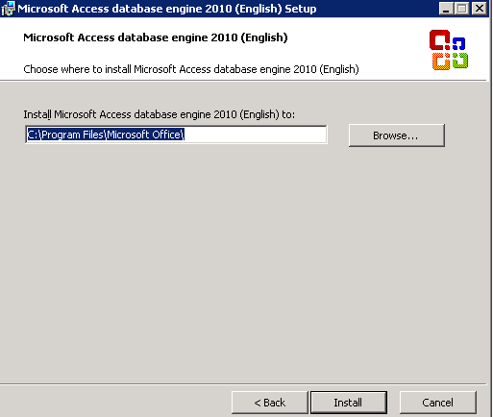
Getting Started – Installation – Access DB Engine
Select the destination folder and click “Install”.

Slide 17
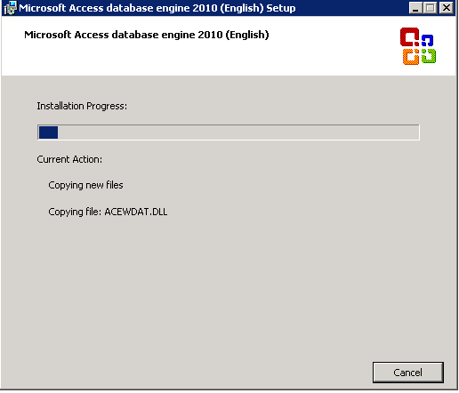
Getting Started – Installation – Access DB Engine
Installation progress can be observed.

Slide 18
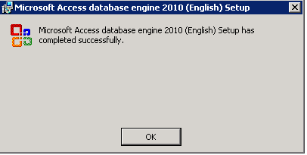
Getting Started – Installation – Access DB Engine
After successful installation, click on “OK” to exit the installation process.

Slide 19
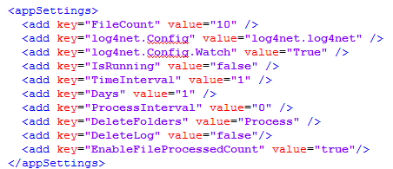
Getting Started – Configuration
WD.XLC.WIN.exe.config
AppSettings
FileCount : Its the integer value which represents the maximum number of files processed by application simultaneously.
Inbox: It is the main repository of files to be processed. Set the value as absolute path of inbox folder. The application will move files from Inbox folder to its working folder for further processing.
Log4net.Config: It is the configuration file name for Log4Net.
IsRunning: If set as “true”, on application start, the application will directly start the “Loader” tab and set the toggle button to “on”. This is helpful if user wants to start processing of CSV files immidialty; after application starts. The possible values for this setting are “true” or “false”.

Slide 20
Getting Started – Configuration
TimeInterval : It is the time between two cycles of simultaneous file processings. The value is specified in milliseconds.
Days: Its is the value in number of days to delete the files from specified folders. All the files older than (in days) this value are deleted.
ProcessInterval: Its an integer value represents number of Hours from mid-night to start the deletion process. During this process, all the old files are deleted from specified folders. The value represents number of hours. By Default the deletion process is executed by midnight. So “0” means the deletion process will be executed exactly at midnight.
DeleteFolders: It’s a comma separated list of folder names from which the old files need to be deleted.
DeleteLog: It specifies either the logs should be generated by the application for deleted files from the specified folders or the logs are not required. The possible values are "true" or "false".
EnableFileProcessedCount: This flag enables the application to log the processed file count each day. The log values are saved in “FileProcess” table in database. The possible values for this setting are "true" or "false".

Slide 21
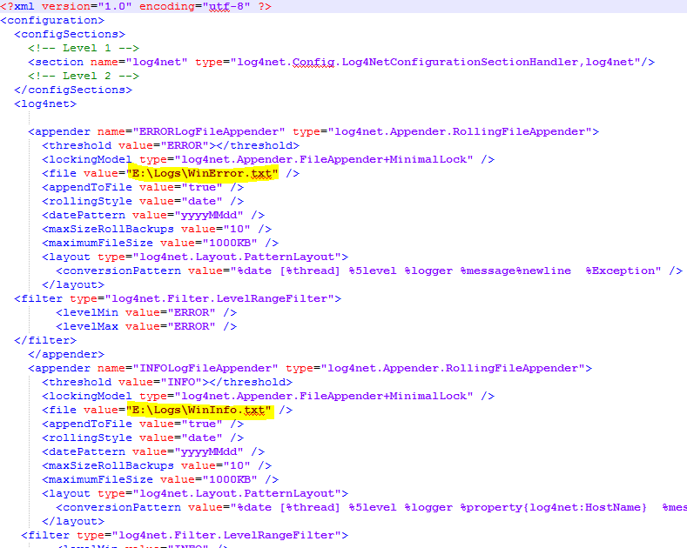
Getting Started – Configuration
Lof4net.log4net
Specify the path of error log file and activity log file.
User can select any of the folder on the machine.
Make sure the folder must exist. However, the files can be created by application if not already exist.

Slide 22


Getting Started – Execution
Application can be started from
Either by double click the XLC loader icon on desktop
Or by selecting “Loader” from Start Menu > All Programs > Western Digital > XLC Loader

Slide 23
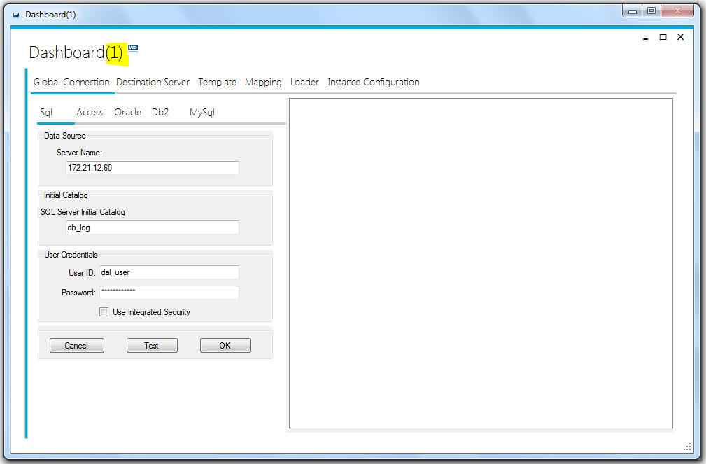
Getting Started – Execution
The XLC loader is multi instance application i.e. more than one instances of the application can be executed simultaneously. Each instance is numbered uniquely starting from 1.

Slide 24
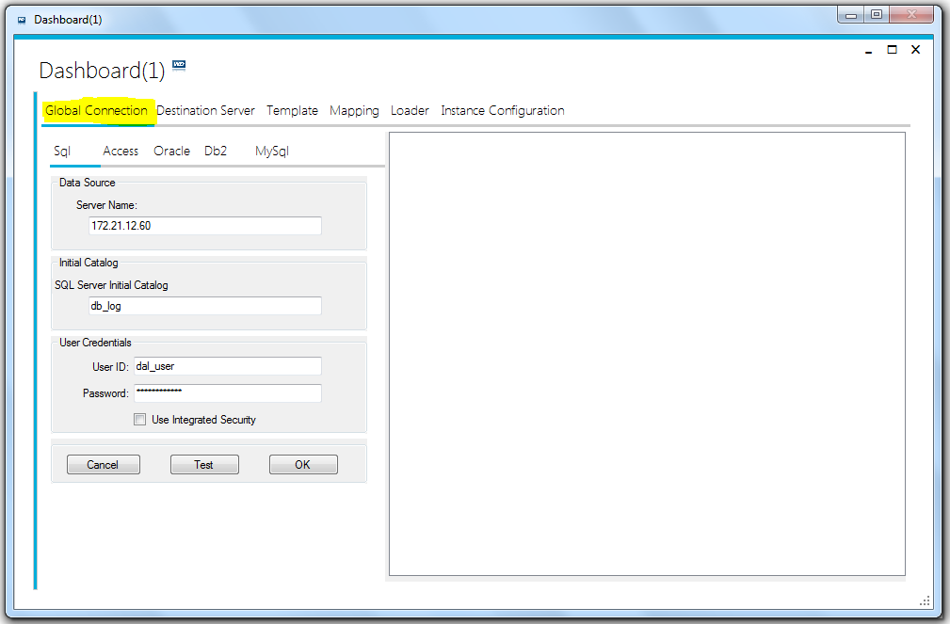
Global Connection
Can define connection of database to save configuration like templates and server connections
Select the appropriate Database type.
Enter the required database connection credentials in to the fields.
Click on “Test” button to check if the connection is successful
Click “OK” button to save the changes.

Slide 25
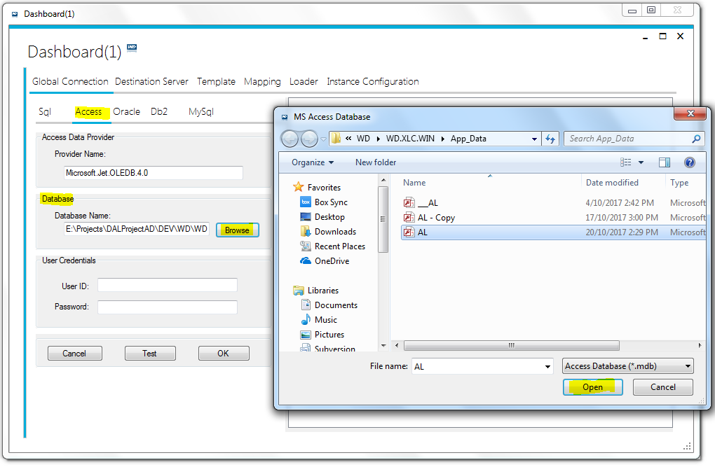
Global Connection
For example:
select Access
Click on “Browse” button to select the Access file.
Select the access database file and click “Open” button.
If the Access database file is password protected, enter the user ID and password.
Click on “Test” button to test the connect.

Slide 26
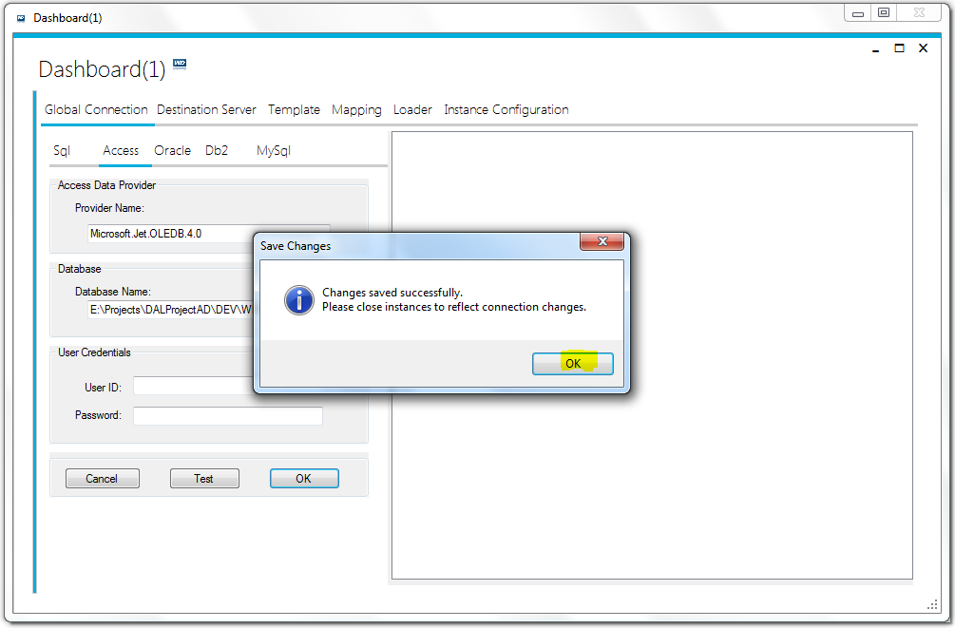
Global Connection
If the changes are saved successfully, it may only reflect after the application restart.
Close the existing running application
Restart the application

Slide 27
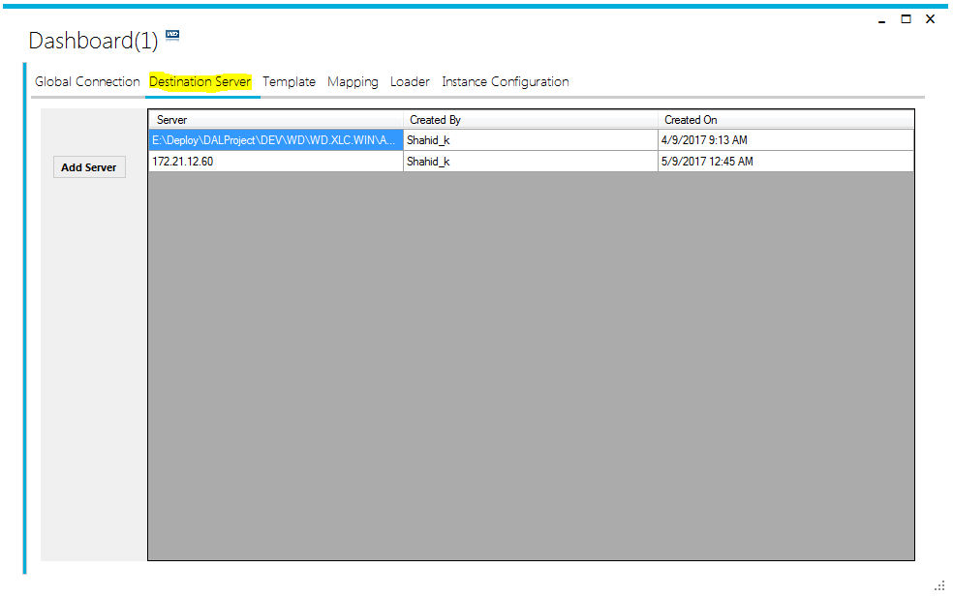
Destination Server
Can add any type of database server.
SQL server
Oracle
DB2
Access
Displays the list of servers to be associated with template and to save the data from CSV files.

Slide 28
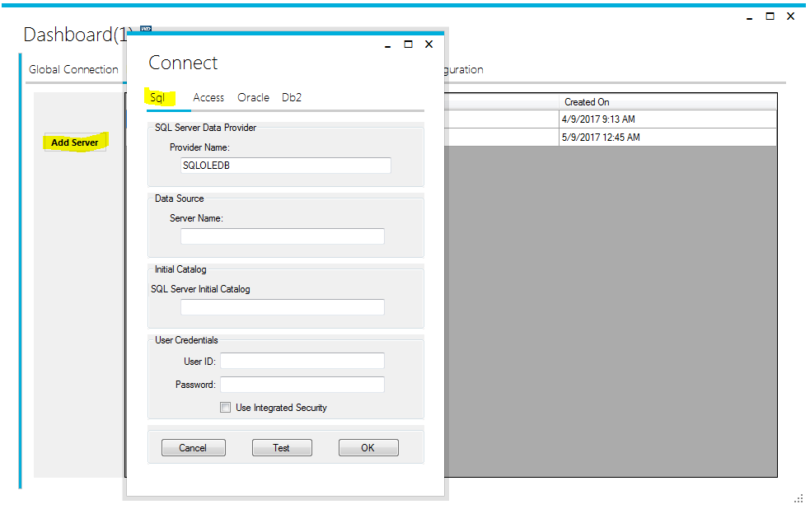
Destination Server
To add new server
Click on “Add Server” button.
A server selection dialogue will appear
Select the appropriate server and fill the required fields.
Click ok to save the server information.

Slide 29
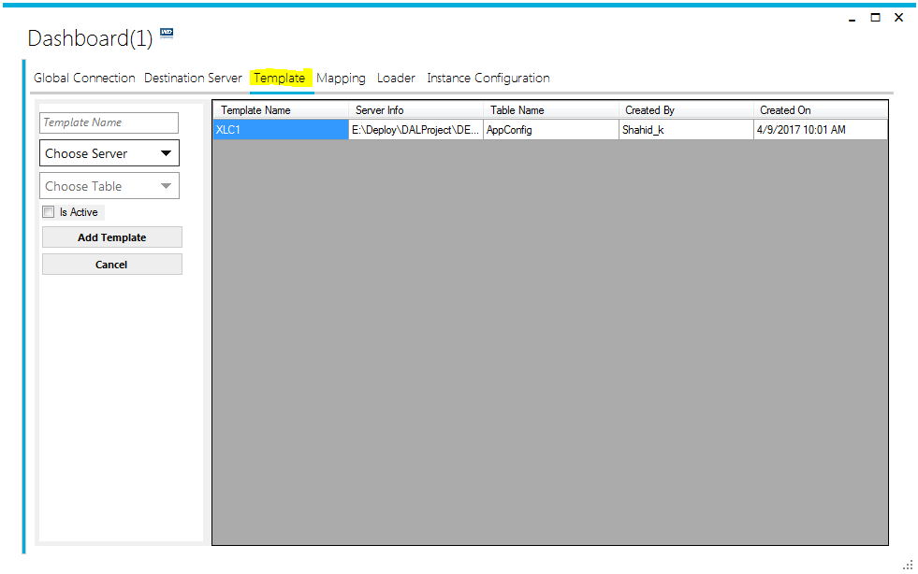
Template
Templates are the mapping between raw data of CSV files and database structures.
It provides information of each value, its target column in particular table, datatype and unique value constraint.
Each template is associated with specific database server.

Slide 30
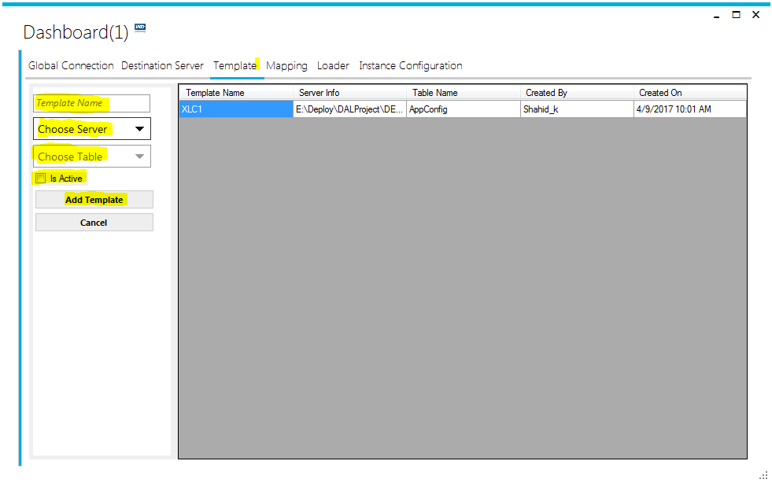
Template
To Create a new Template
Enter a unique “Template Name” as Rec_Id in CSV files
Choose the database server from dropdown list.
The table drop down list will be populated by system. All the tables of selected database server will be populated in the list.
Select the target table
Select the IsActive checkbox
Click on “Add Template” to save the template.

Slide 31
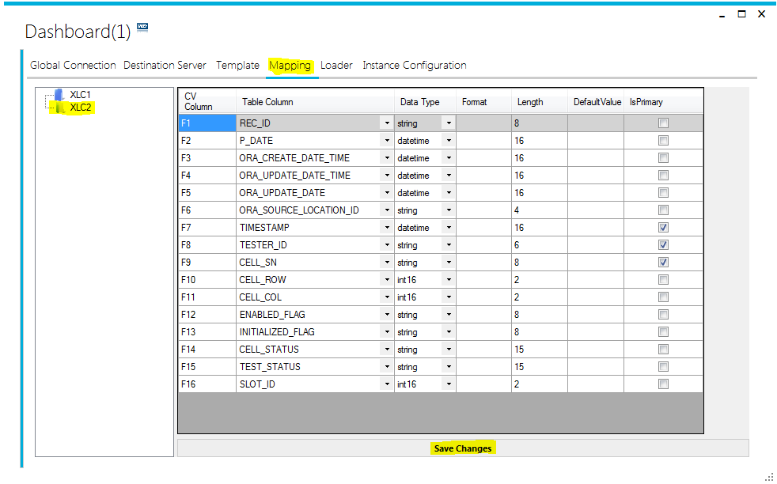
Mapping
It is to map table columns to CSV values. By default it loads all columns of the associated table for the selected template.
“CV Column” is the order of values in CSV file been read by application.(Mandatory)
Each value must have prefix “F”
After “F”, the number is the location of the value in row of CSV file.
The number must be unique for each row in this column. Duplicate values may result error during file processing.
“F1” must always be associated with “REC_ID” column of database table.
“F1” cannot be change or deleted.

Slide 32
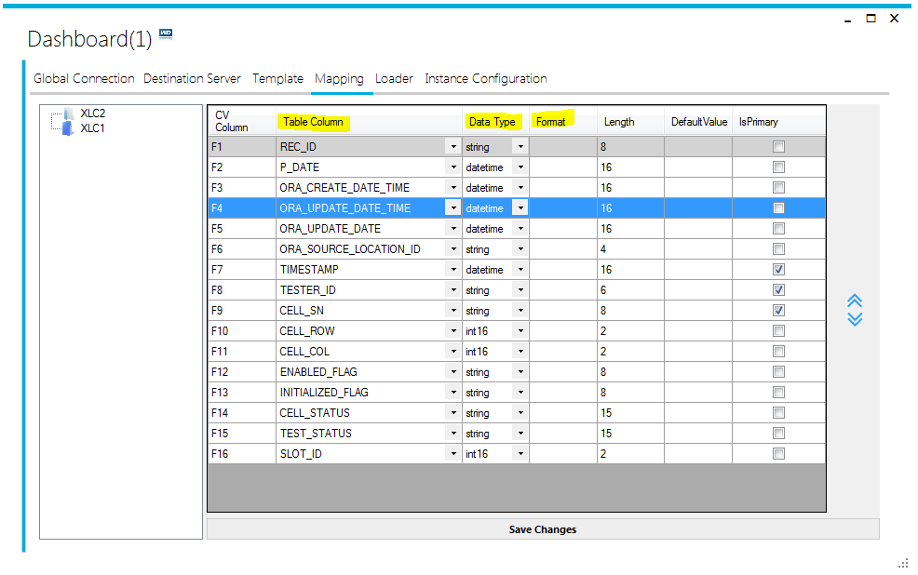
Mapping
“Table column” is the column name of associated table. That column is attached to that particular value of CSV file. (Mandatory)
“Data Type” Column is to define the data type of the values.(Mandatory)
“Format” column is to define the format of the value read from CSV file.

Slide 33
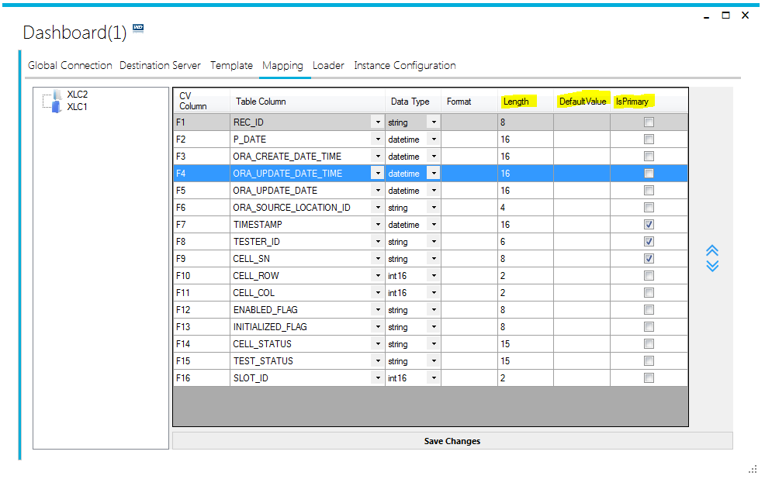
Mapping
“Length” column is to define the character length of the value to be inserted in the database. It is mandatory for columns with string datatype.
“Default Value” column is to define the default value if any.
“Is Primary” column is to set if the column has primary key or part of unique key index in database.
“REC_ID” column will always be part of primary key.

Slide 34
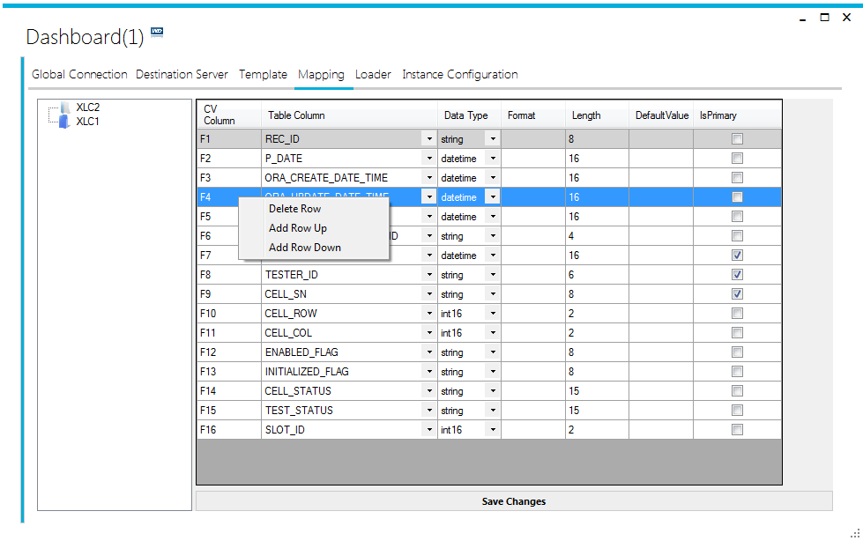
Mapping
Select and right-click on any row, will show a menu list.
Delete Row: will delete the selected row
Add Row Up: create a new empty row above the selected row.
Add Row Down: create an empty row below the selected row

Slide 35
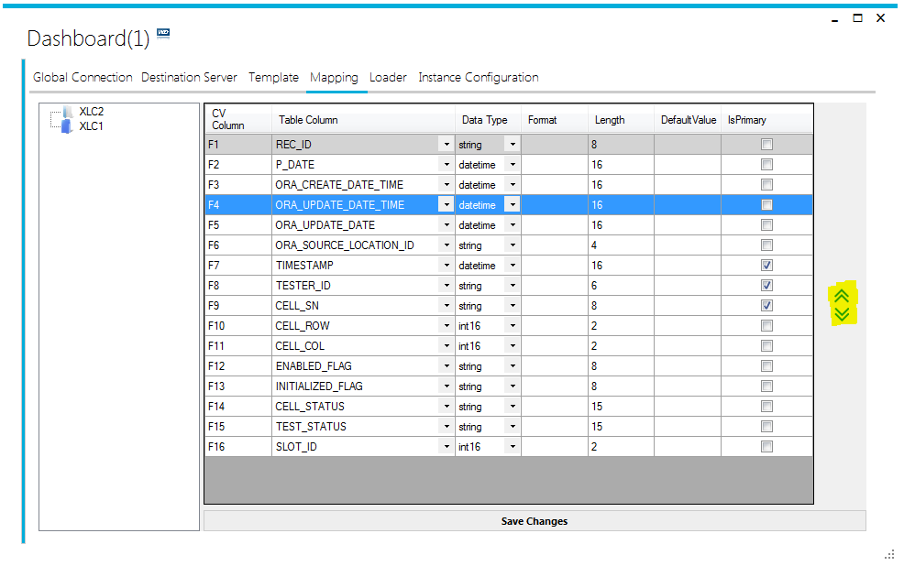
Mapping
Up Arrow will move the selected row up
Down Arrow will move the selected row down

Slide 36
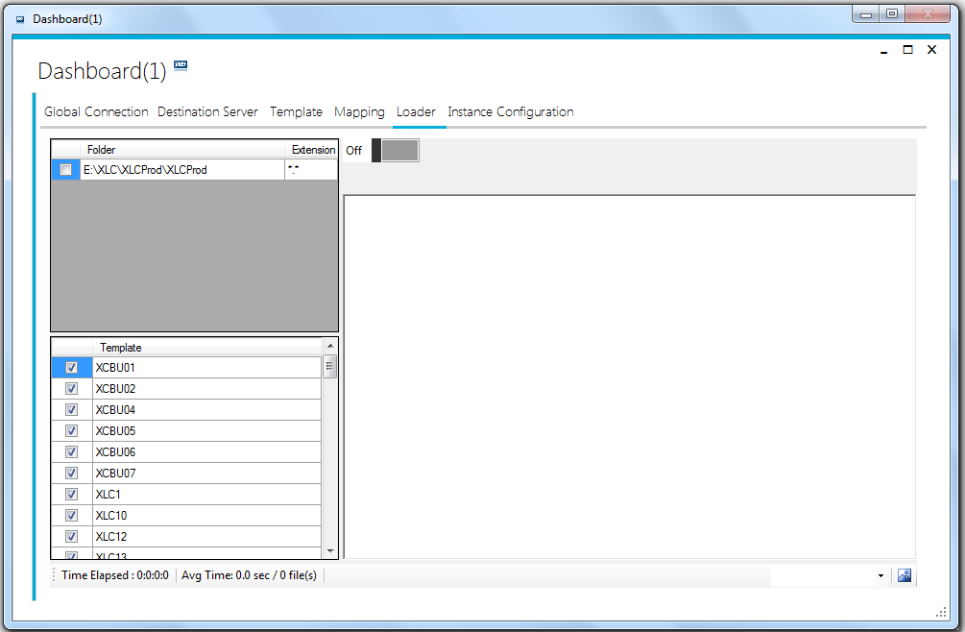
Loader
It is to process the files and see the results while application is processing files.
Select the “Working” folder path from the folder list available at top left Hand side.
Select the template(s) to be processed during the execution, from the template list available at bottom-left corner.
Must select at least one template
Click on the switch button to turn-on the file processing.

Slide 37
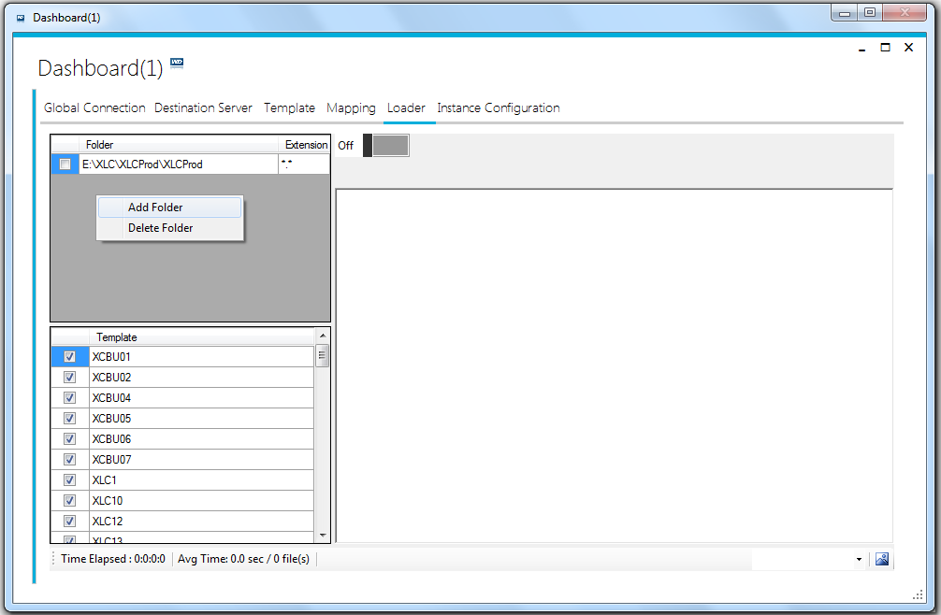
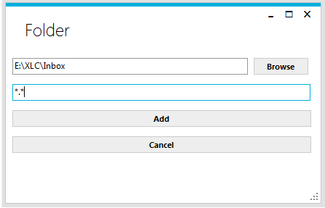
Loader
To add the Inbox folder path, from where the loader application reads the CSV files:
Right click in the folder list area and choose “Add Folder”.
The folder selection dialogue box will appear
In Folder path dialogue box click on browse to select the folder
Enter the file selection expression. It defines which files to be read by Loader application.
For all files in the folder put “*.*”
Click on Add button to add the selected folder in the folder list.

Slide 38
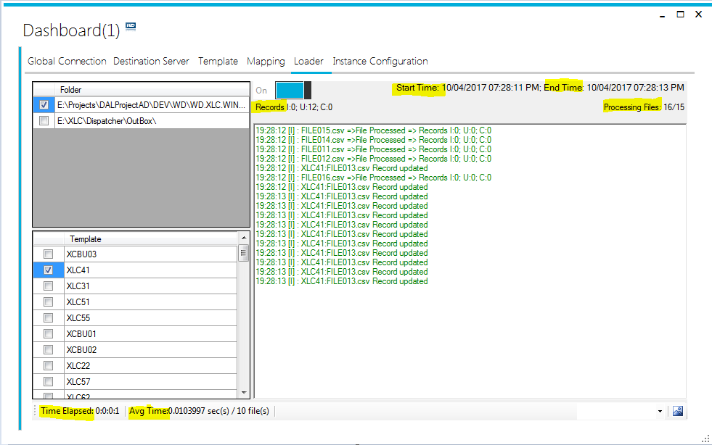
Loader
During the processing of files, the application shows the statistical results e.g
Start Time: Date & Time when processing starts
End Time: Current Date & Time or when the processing stops.
Time elapsed
Number of records Processed
I = Number of records inserted
U = Number of records updated
C = Number of “Corrupt” records
Number of files processed

Slide 39
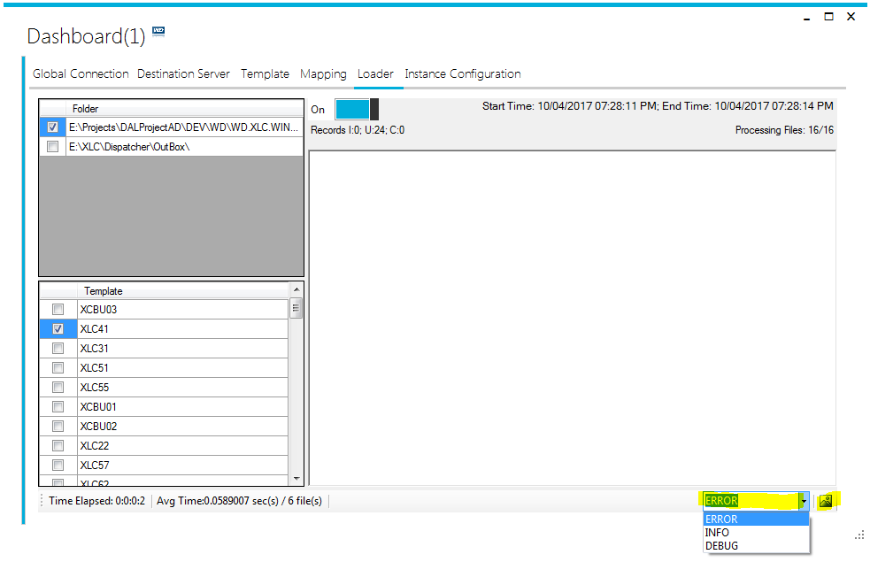
Loader
By selecting any option from bottom drop down list, will open the log file in notepad.
Error: opens the Error log file
Info: opens the info logs
Debug: opens the debug logs of application.
Click on the icon at bottom-right corner to open the log folder.

Slide 40
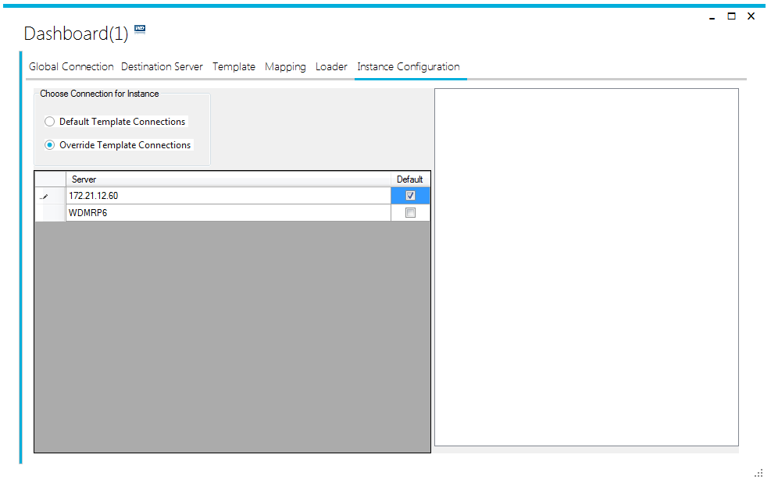
Interface Configuration
Interface configuration tells where to dump the CSV data during the processing.
Default Template connection
By selecting this option the data will be saved to the database connection associated with each template.
Override Template Connection
By selecting this option the associated Database connection will be ignored and all the data will be saved to selected database server.

